Slide 1

Empowerment through Engagement:
Implementing Student-Led IEPs
Mandy Ellis and Brooke Mair
NQEC Conference 2011
Dunlap School District #323

Slide 2

Objectives
Introduction to Dunlap School District
Benefits of Student-Led IEPs
Implementation Guidelines
Obstacles of Implementation
Stakeholder Involvement

Slide 3

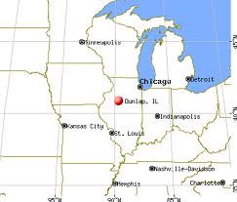
K-12 Large Unit District
Total Enrollment: 3,671
Serving an estimated 12,500 residents
62 Square Miles

Slide 4

School Enrollment
Number of Schools: 7
Elementary Schools (Grades K-5)
  Banner Elementary: Enrollment – 463
  Dunlap Grade School: Enrollment – 290
  Ridgeview Elementary School: Enrollment – 452
  Wilder-Waite Grade School: Enrollment – 386
Middle Schools (Grades 6-8)
  Dunlap Middle School: Enrollment – 419
  Dunlap Valley Middle School: Enrollment – 420
High Schools (Grades 9-12)
  Dunlap High School: Enrollment – 1,086

Slide 5
Staff and Program Information
3.5 early childhood teachers
7 Elementary cross-categorical teachers
2 Elementary instructional teachers
2 Elementary life skills teachers
4 Middle school cross-categorical teachers
1 Middle school instructional teacher
1 Middle school life skills teacher
5 High school cross-categorical teachers
2 High school life skills teachers
7 Speech Pathologists

Slide 6

Student Profile
Demographics:
  76.9% White
  3.9% African American
  12.9% Asian/Pacific Islander
  2.4% Hispanic
  0.1% Native American
  3.8% Multi-racial/Ethnic

Slide 7
Student Profile
Special Education Students: 12.2%
English Language Learners: 4%
Students Qualifying for Free and Reduced Lunch: 5%
Attendance Rate: 95.7%
High School Graduation Rate: 99.6%
High School Dropout Rate: 0.4%

Slide 8
Special Education Numbers
K-5 IEP
100 Students
IEP 6-8
68 Students
IEP 9-12
80 Students
248 TOTAL

Slide 9
Nobody Escapes Continuous Improvement

Slide 10

Take a Test Drive
Read the Owner’s Manual
Set Direction
Follow the Map
Maneuver the Obstacles
Start their engines
Provide Opportunity for Feedback
If you don’t know where you are going, any old road will get you there….

Slide 11

Student Benefits of Student-Led IEPs
Reading and Writing in Context
Goal Setting
Self-Advocating
Using Presentation Skills
Listening and Responding
Compromising
Summarizing
Alignment to District Goals and Strategic Plan

Slide 12

Additional Benefits of Student-Led IEPs
Structured Meeting Flow
Parent Involvement
Family-Centered
Increased Team Dialogue

Slide 13

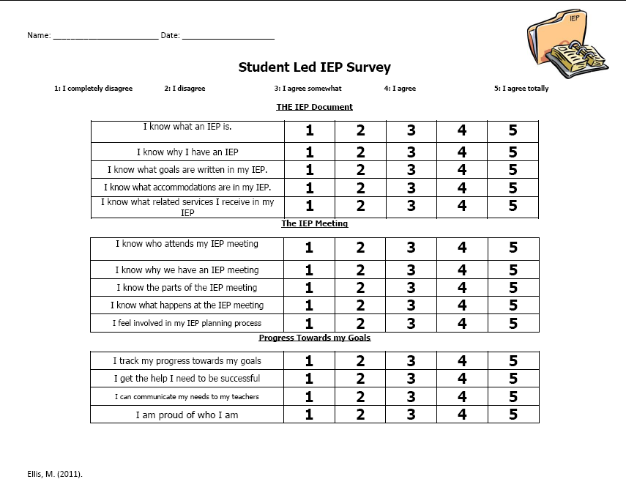
Take a Test Drive
Student Survey
Ongoing
Drive Instruction
Provide Focus
Dashboard View

Slide 14
Feedback Drives Improvement

Slide 15
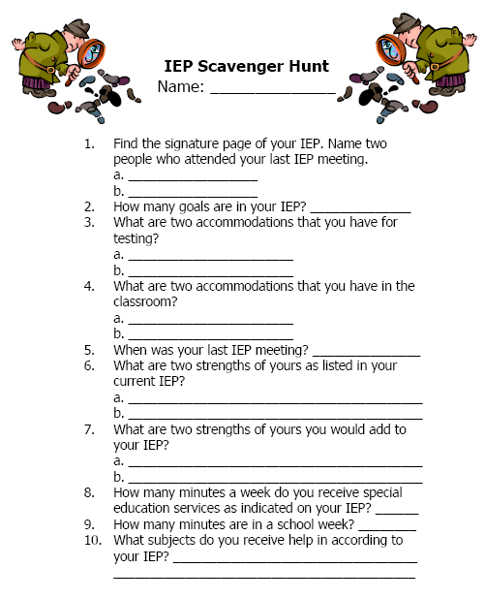
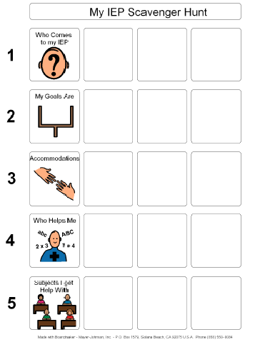
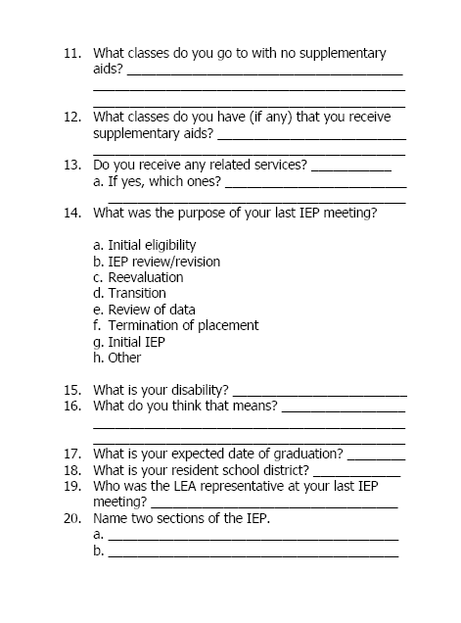
Read the Owner’s Manual
Age-Appropriate Dialogue
Safe Environment

Slide 16

Re-Read the Owner’s Manual
“Introduction to Your IEP” Presentation by Special Education Teacher
  What an IEP is
  Why you have an IEP
  What goals are written in your IEP
  What accommodations you have
  What related services are
  What an IEP meeting is and how to present at your own IEP!

Slide 17

Set Direction
Student strengths
Goals
Accommodations
Feedback from stakeholders
A Plan for Services and Placement

Slide 18
Follow the Map
Introductions | My strengths | My progress towards current goals
My services and placement | My IEP Meeting | My teacher’s Input
My accommodations | My goals for the future | My parents’ input

Slide 19
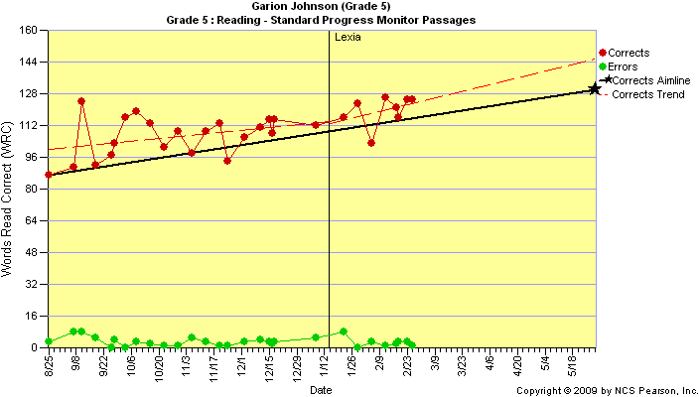
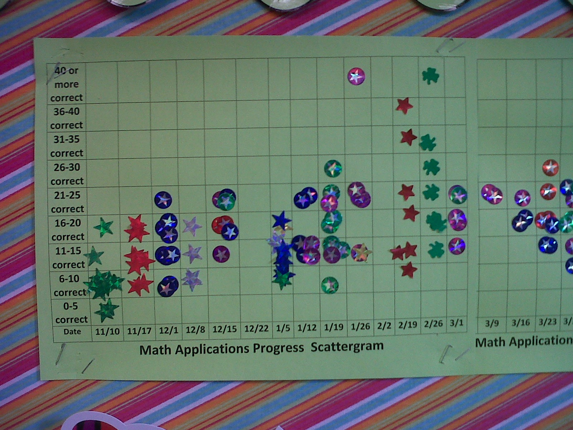
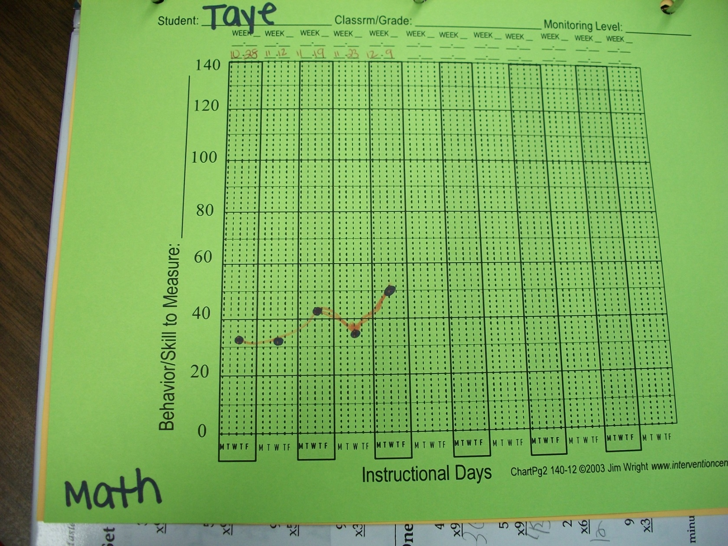
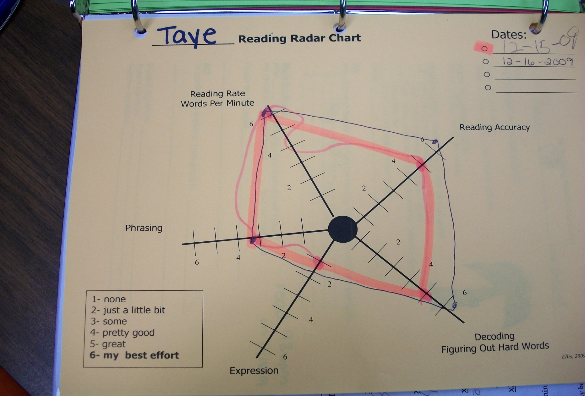
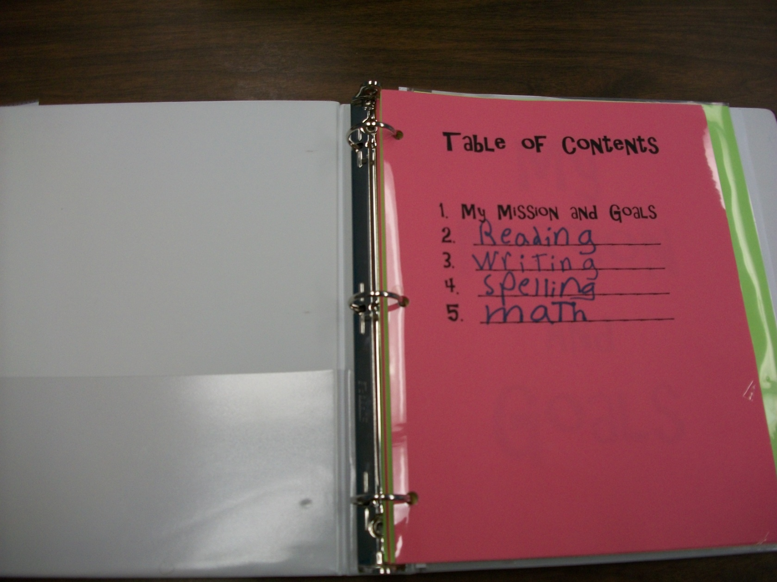
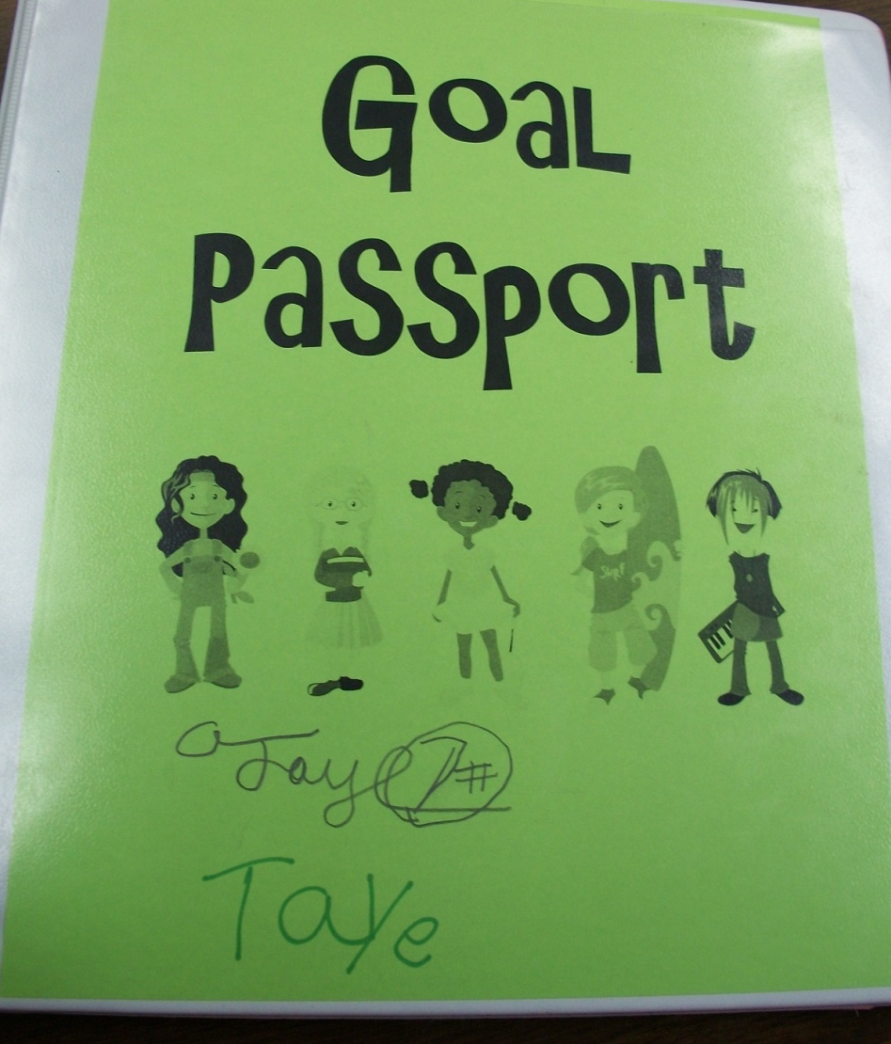
Track Student Progress

Slide 20
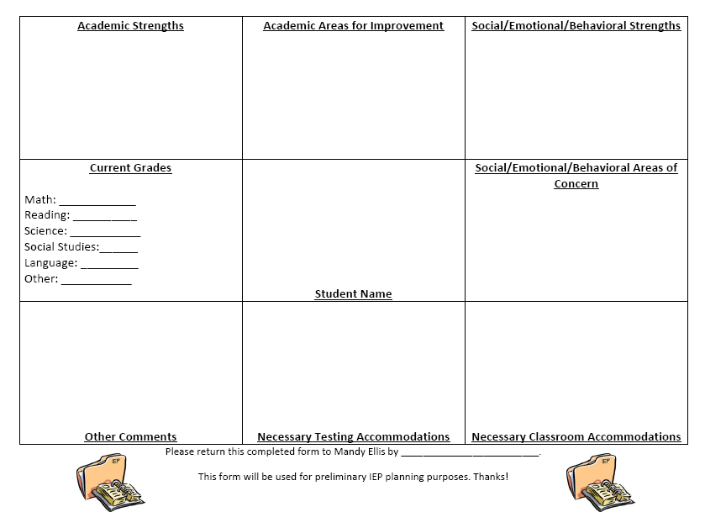

Slide 21
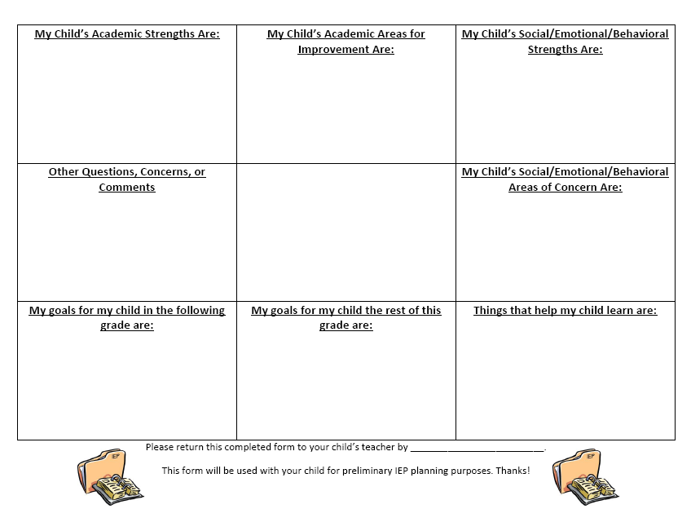

Slide 22
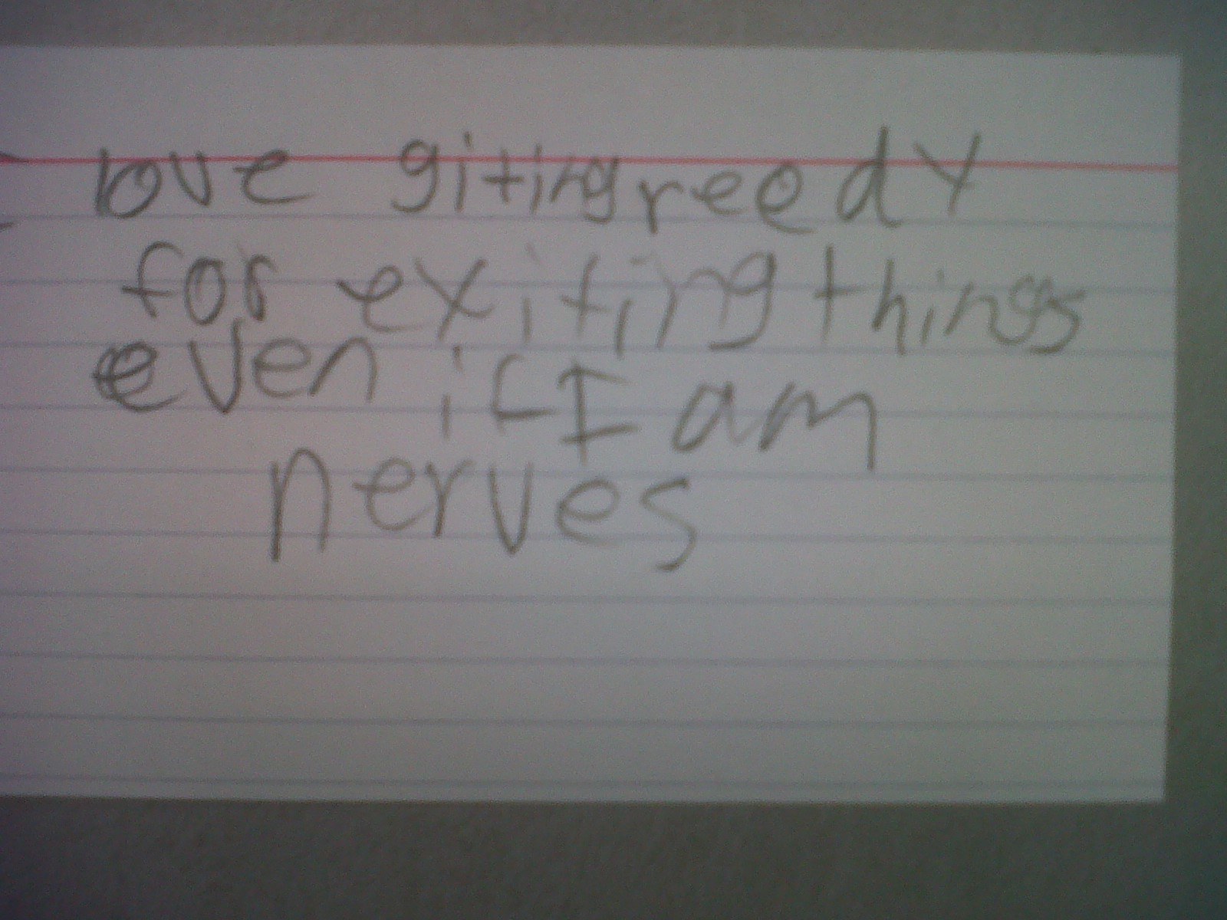
“I love getting ready for exciting things, even if I am nervous.””
4th Grade Student

Slide 23
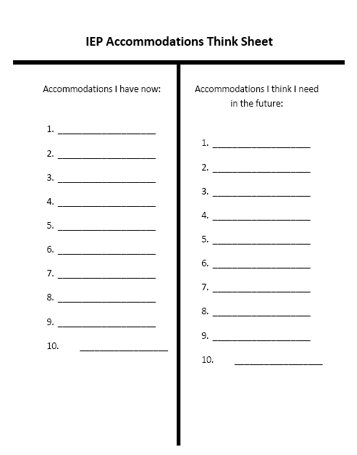

Slide 24
Additional Activities to Consider
Write a statement of their present levels of performance
Compose business letters and address envelopes inviting IEP members to the meeting
Conduct self-assessment of learning styles
Write friendly thank you letters to the team
Notes:
Through these activities, students become more aware of their abilities, develop key communication skills and reinforce 21st century skills.

Slide 25

Maneuver the Obstacles
Student Concerns
Parent Concerns
Student Ability to Present
Soliciting Stakeholder Feedback is vital throughout the process!

Slide 26

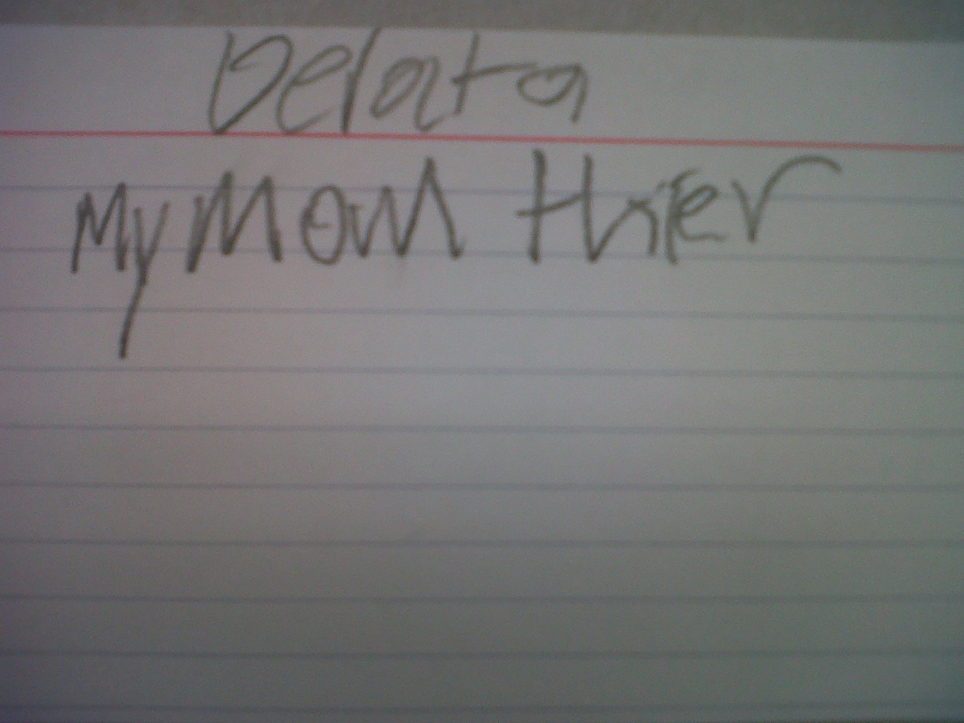
Delta: “My Mom There”
5th Grade Student

Slide 27
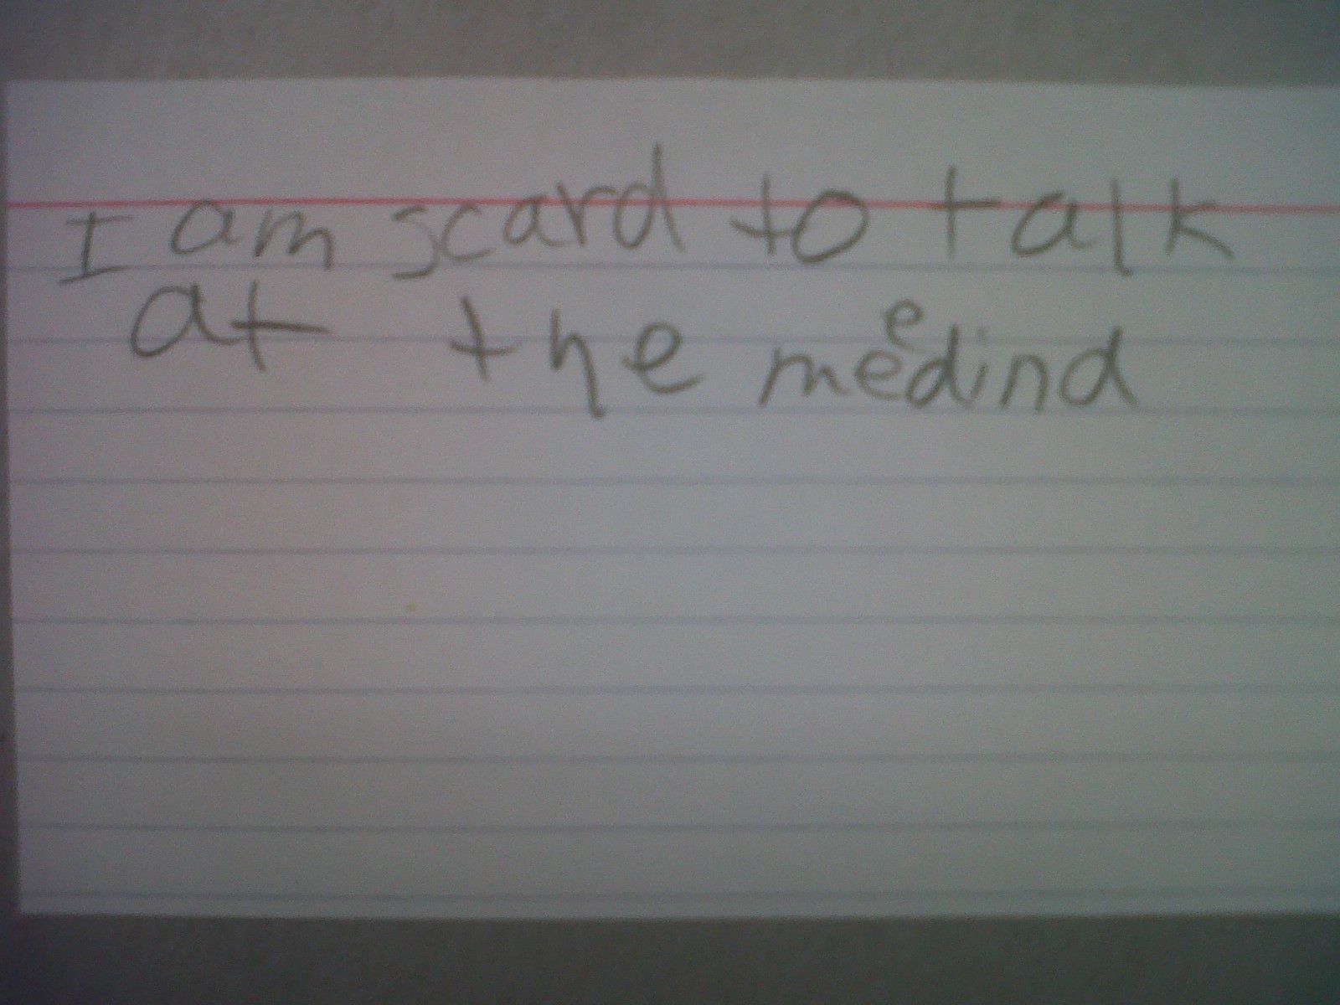
Delta: “I am scared to talk at the meeting!”
5th Grade Student

Slide 28
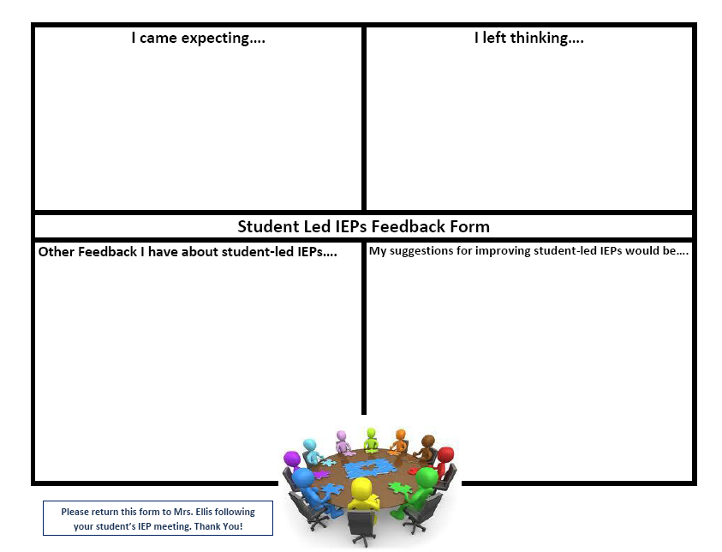
Test Drive
Set Direction
Use a Map

Slide 29
Start Your Engines… IEP Day!
Meetings are allotted 45 minutes
Students greet the IEP team members
Students facilitate introductions
Students begin the IEP meeting
Students are prompted to engage team members
All members of the IEP team provide feedback.

Slide 30
Celebrate Student Success
Student-led IEPs are the vehicles for driving continuous improvement and developing 21st century skills.
As a special education teacher, there is no greater victory than seeing a child empowered through engagement in their learning.

Slide 31
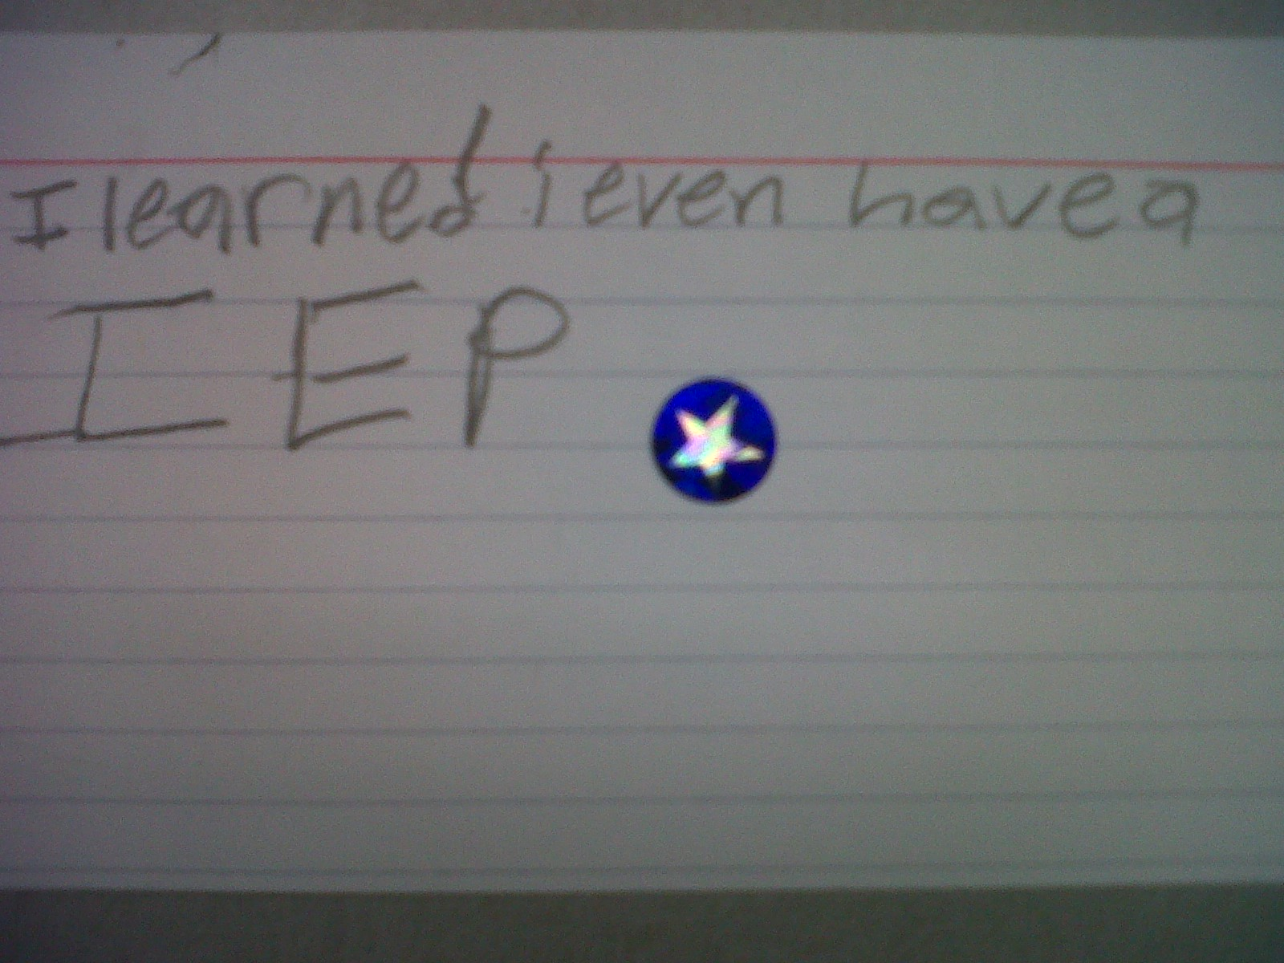
4th Grade Student: “I learned I even have an IEP”

Slide 32

Questions/Comments

Slide 33

Contact Us
Brooke Mair
  Director of Special Services
  bmair@dunlapcusd.net
Mandy Ellis
  Special Education Teacher/CI Trainer
  mellis@dunlapcusd.net

Slide 34
References
For electronic resources created and used to implement student-led IEPs, visit Mandy Ellis’ Wikispace: http://wilderwaiteresourceroom.wikispaces.com/individualized+education+planning.
For more information about Dunlap School District #323, visit www.dunlapcusd.net/pages/splash.aspx
Mandy Ellis, “Empowerment Through Engagement: Implementing Student-Led IEPs,” American Society for Quality, http://asq.org/edu/2011/07/continuous-improvement/empowerment-through-engagement-implementing-student-led-ieps.pdf
Becky Wilson Hawbaker, “Student-led IEP meetings: Planning and Implementation Strategies,” TEACHING Exceptional Children Plus, Vol. 3, No. 5, 2007, http://journals.cec.sped.org/tecplus/vol3/iss5/art4.

